Slide 1

Data Exploration, Understanding, and Visualization
Neha Baranwal

Slide 2
Content
What is Data?
Understanding of data
Analysis of data
Importance of data visualization
Visualization tools
Examples

Slide 3




What is data?
Lots of data is being collected and warehoused
Web data, e-commerce
Financial transactions, bank/credit transactions
Online trading and purchasing
Social Network

Slide 4

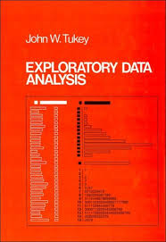
Data Analysis 1977
Based on insights developed at Bell Labs in the 60’s
Techniques for visualizing and summarizing data
What can the data tell us? (in contrast to “confirmatory” data analysis)
Introduced many basic techniques:
5-number summary, box plots, stem and leaf diagrams,…
5 Number summary:
extremes (min and max)
median & quartiles
More robust to skewed & longtailed distributions

Slide 5
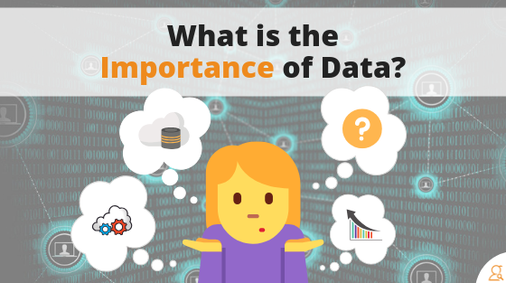

Slide 6
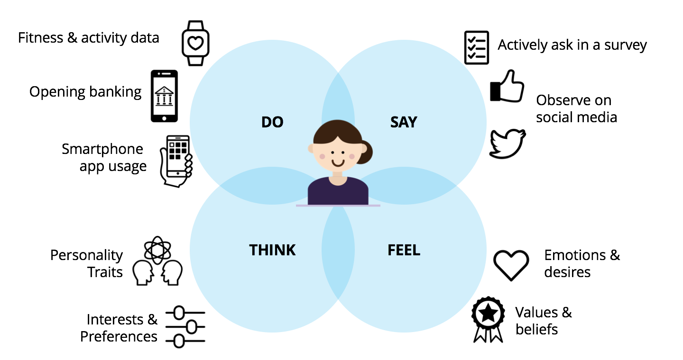

Slide 7
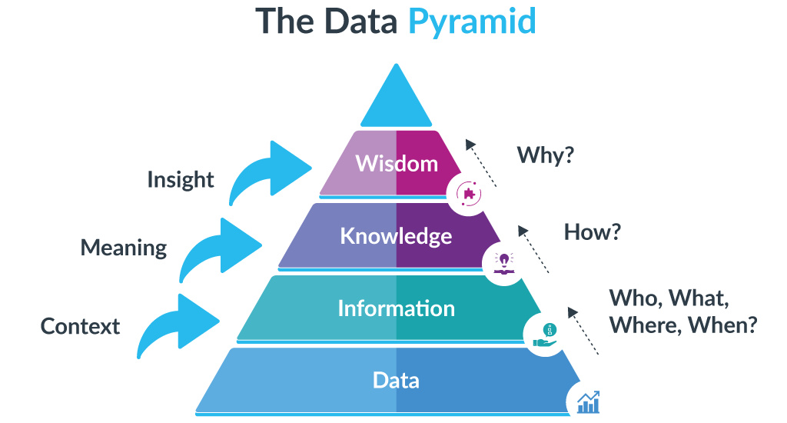

Slide 8
What is EDA?
It is an approach that is used to analyze the data and discover trends, patterns, or check assumptions in data with the help of statistical summaries and graphical representations.
It is used for gaining a better understanding of data aspects like:
– main features of data
– variables and relationships that hold between them
– identifying which variables are important for our problem

Slide 9
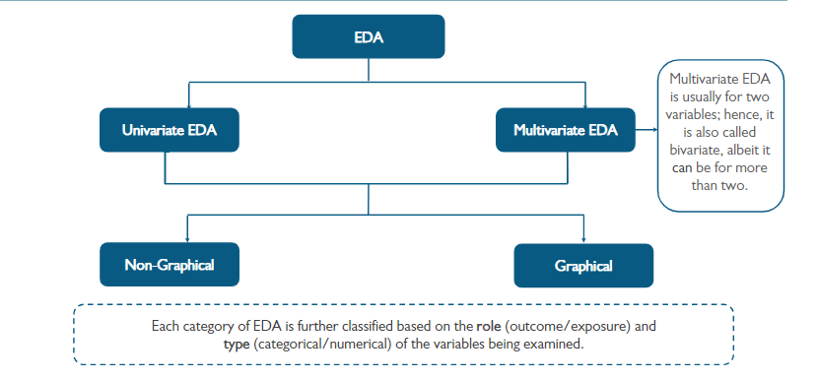
Types of EDA

Slide 10
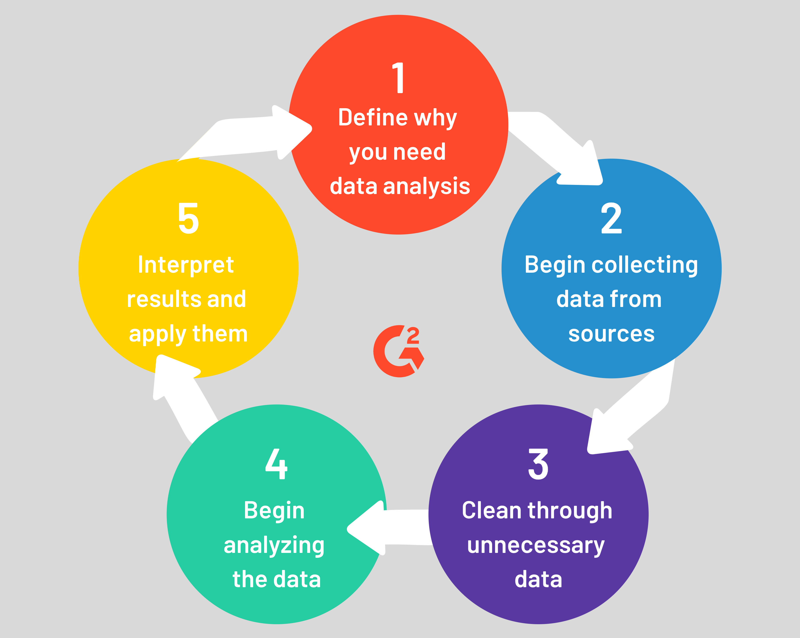
What Is Data Analysis?

Slide 11
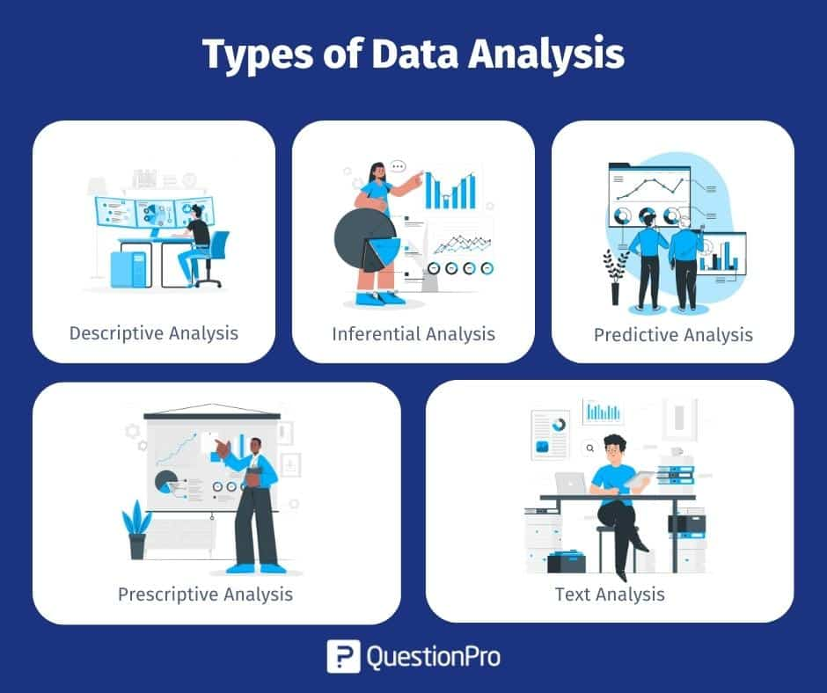
What Is Data Analysis?

Slide 12
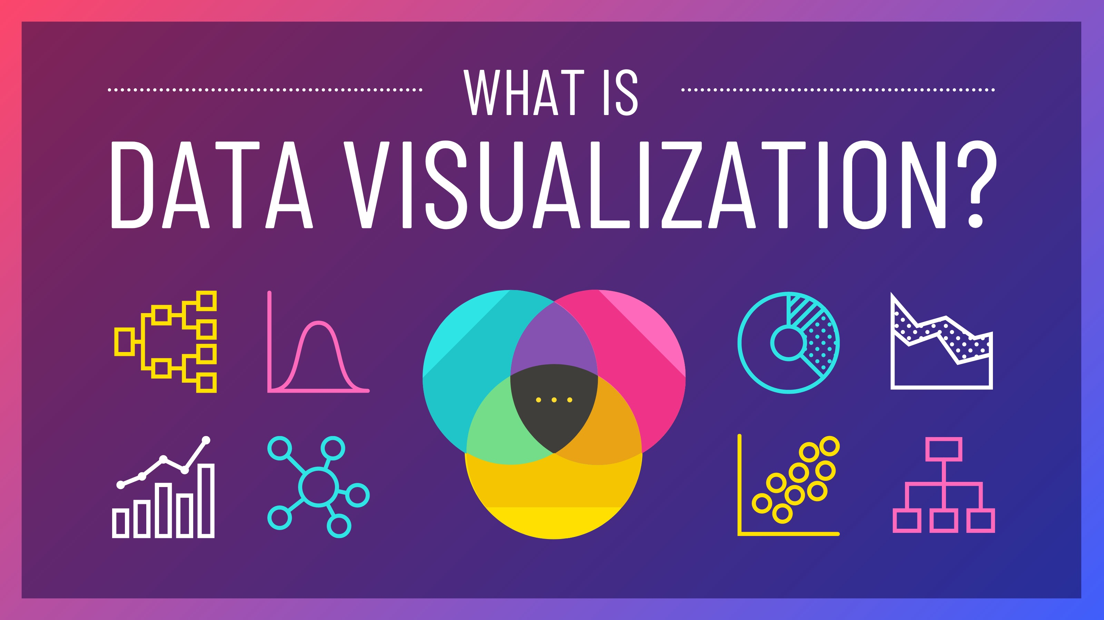

Slide 13
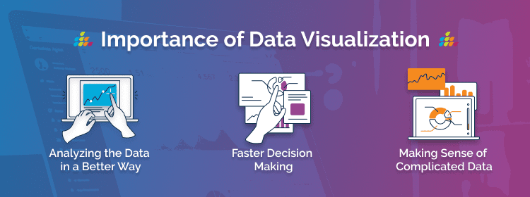
Why Data Visualization is important?

Slide 14

How to do Data Visualization?

Slide 15
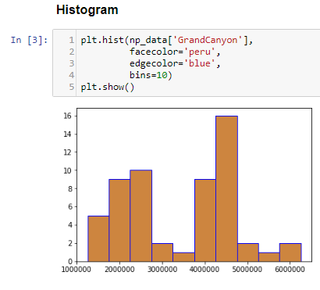
Histogram
A histogram takes in a series of data and divides the data into a number of bins. It then plots the frequency data points in each bin (i.e. the interval of points). It is useful in understanding the count of data ranges.
When to use: We should use histogram when we need the count of the variable in a plot.
eg: Number of particular games sold in a store.
Implementation: Histogram

Slide 16
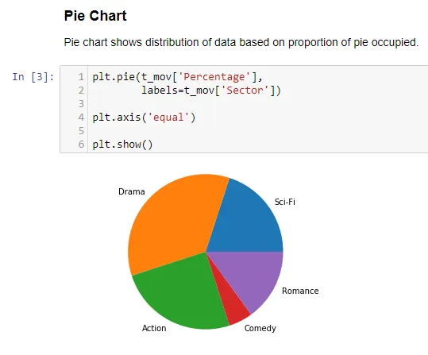
Pie Chart
It is a circular plot which is divided into slices to illustrate numerical proportion. The slice of a pie chart is to show the proportion of parts out of a whole.
When to use: Pie chart should be used seldom used as It is difficult to compare sections of the chart. Bar plot is used instead as comparing sections is easy.
Implementation: Pie Chart

Slide 17
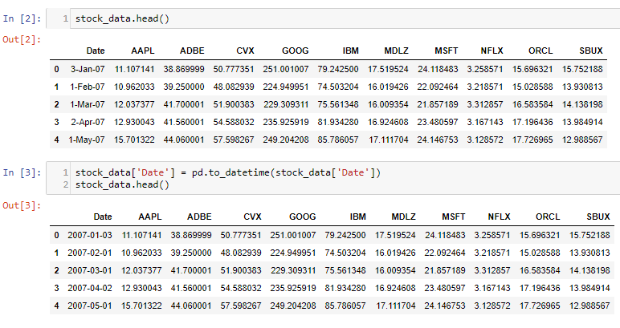
Time Series by line plot
Time series is a line plot and it is basically connecting data points with a straight line. It is useful in understanding the trend over time.
When to use: Time Series should be used when single or multiple variables are to be plotted over time.
eg: Stock Market Analysis of Companies, Weather Forecasting.

Slide 18
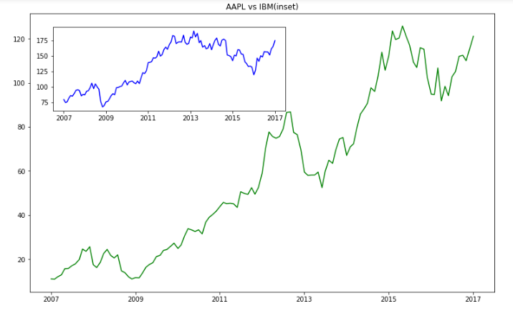
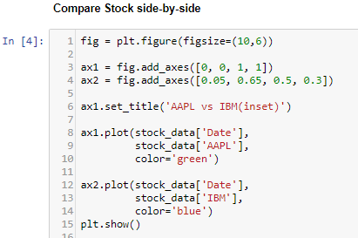
Time Series by line plot
First, Convert Date to pandas DateTime for easier plotting of data.
Implementation: Time Series

Slide 19
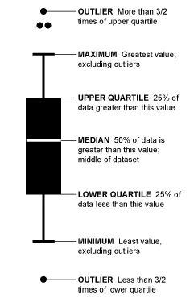
Boxplot
Boxplot gives a nice summary of the data. It helps in understanding our distribution better.
When to use: It should be used when we require to use the overall statistical information on the distribution of the data. It can be used to detect outliers in the data.
eg: Credit Score of Customer. We can get the max, min and much more
information about the mark.

Slide 20
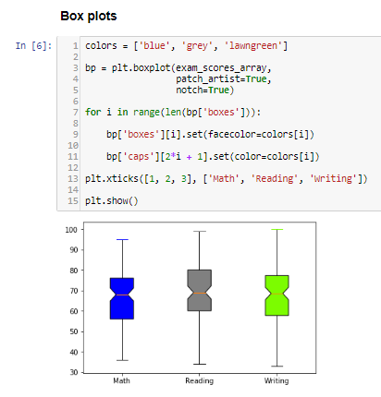
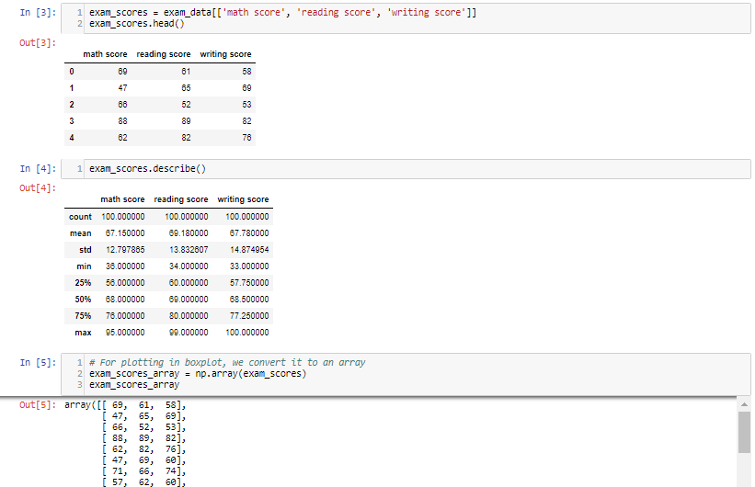
Boxplot
Implementation: Boxplot & Violinplot

Slide 21

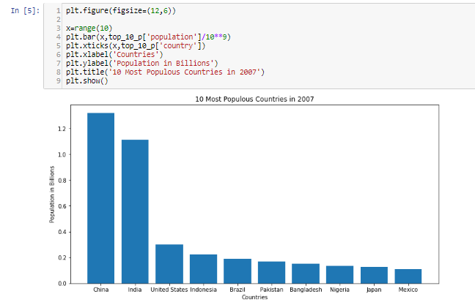
Bar Plot
Bar Plot shows the distribution of data over several groups. It is commonly confused with a histogram which only takes numerical data for plotting. It helps in comparing multiple numeric values.
When to use: It is used when to compare between
several groups.
Eg: Student marks in an exam.
Implementation: Bar Plot
WWW.INTERNSHIPSTUDIO.COM

Slide 22
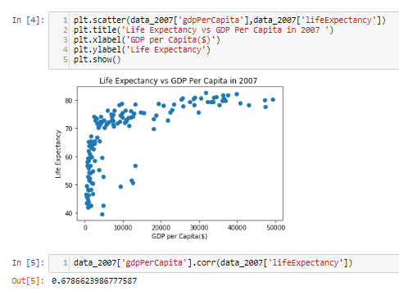
Scatter Plot
Scatter plot helps in visualizing 2 numeric variables. It helps in identifying the relationship of the data with each variable i.e correlation or trend patterns. It also helps in detecting outliers in the plot.
When to use: It is used in Machine learning concepts like regression, where x and y are continuous variables. It is also used in clustering scatters or outlier detection.
Implementation: Scatter Plot

